Slide 1
From Logistic Regression to Neural Networks

Slide 2
Logistic Regression
Important analytic tool in natural and social sciences
Baseline supervised machine learning tool for classification
Is also the foundation of neural networks

Slide 3
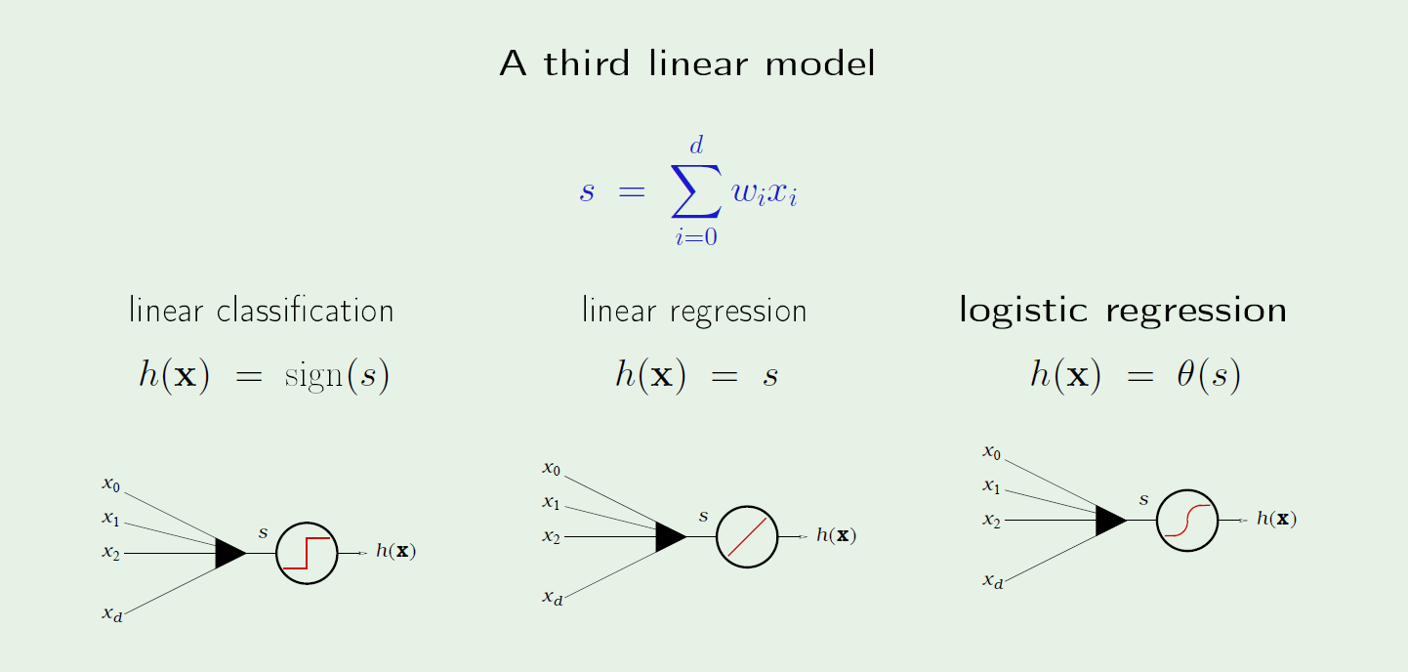

Slide 4
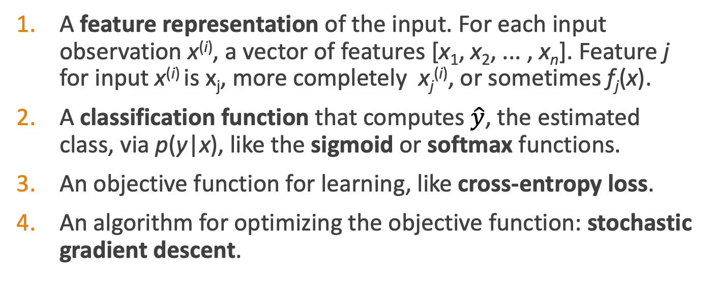
Components of a probabilistic machine learning classifier
Given m input/output pairs (x^{(i),}y^{(i)}):
A feature representation of the input. For each input observation x^{(i)}, a vector of features [x₁, x₂, ... , x_{n}]. Feature j for input x^{(i)} is x_{j}, more completely x_{j}^{(i)}, or sometimes f_{j}(x).
A classification function that computes $\hat{y}$, the estimated class, via p(y|x), like the sigmoid or softmax functions.
An objective function for learning, like cross-entropy loss.
An algorithm for optimizing the objective function: stochastic gradient descent.

Slide 5
The two phases of logistic regression
Training: we learn weights w and b using stochastic gradient descent and cross-entropy loss.
Test: Given a test example x we compute p(y|x) using learned weights w and b, and return whichever label (y = 1 or y = 0) is higher probability

Slide 6
Logistic Regression
Classification in Logistic Regression
Notes:
In this lecture we'll see how to do classification with logistic regression and introduce the important sigmoid function

Slide 7
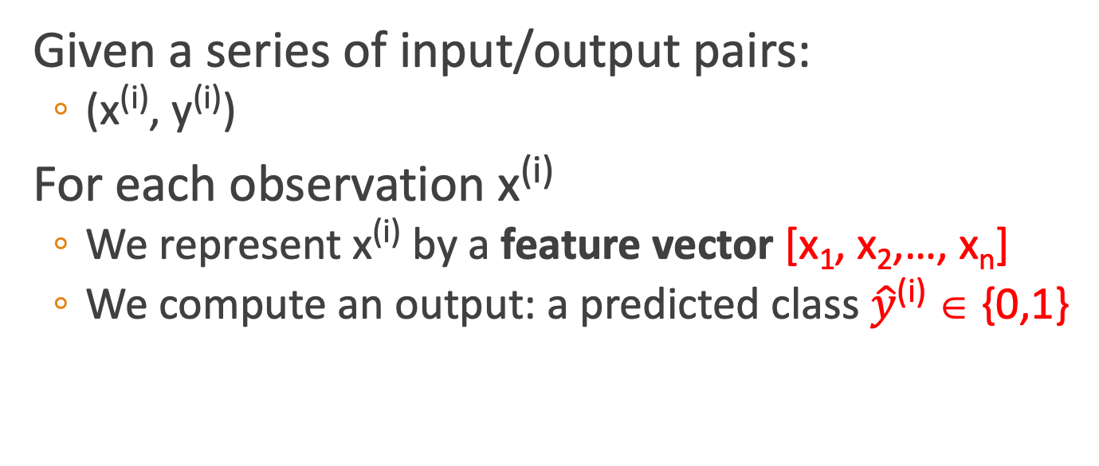
Binary Classification in Logistic Regression
Given a series of input/output pairs:
(x^{(i)}, y^{(i)})
For each observation x^{(i)}
We represent x^{(i)} by a feature vector [x₁, x₂,…, x_{n}]
We compute an output: a predicted class $\hat{y}$^{(i)} ∈ {0,1}

Slide 8
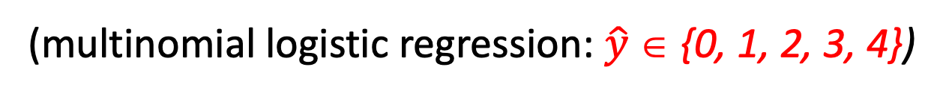
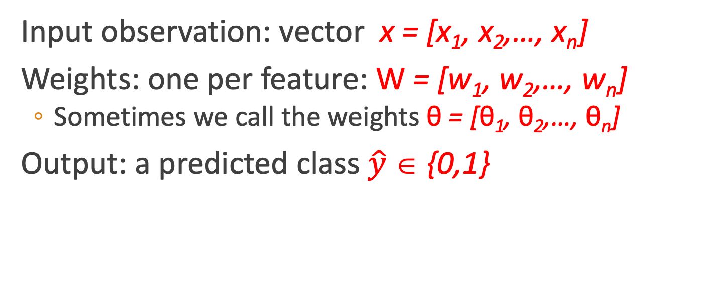
Logistic Regression for one observation x
Input observation: vector x = [x₁, x₂,…, x_{n}]
Weights: one per feature: W = [w₁, w₂,…, w_{n}]
Sometimes we call the weights θ = [θ₁, θ₂,…, θ_{n}]
Output: a predicted class $\hat{y}$ ∈ {0,1}
(multinomial logistic regression: $\hat{y}$ ∈ {0, 1, 2, 3, 4})

Slide 9
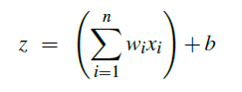
How to do classification
For each feature x_{i}, weight w_{i} tells us importance of x_{i}
(Plus we'll have a bias b)
We'll sum up all the weighted features and the bias
If this sum is high, we say y=1; if low, then y=0. Following notation is equivalent matrix form
Notes:
The bias term, also called the intercept, is another real number that’s added to the weighted inputs. In the rest of the book we’ll represent such sums using the dot product notation from linear algebra. The dot product of two vectors a and b, written as a · b is the sum of the products of the corresponding elements of each vector.

Slide 10
But we want a probabilistic classifier
We need to formalize “sum is high”.
We want a model that can tell us:
p(y=1|x; θ)
p(y=0|x; θ)

Slide 11
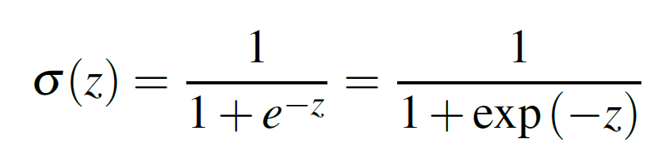
The problem: z isn't a probability, it's just a number!
Solution: use a function of z that goes from 0 to 1
Notes:
nothing in Eq. 5.3 forces z to be a legal probability, that is, to lie between 0 and 1. In fact, since weights are real-valued, the output might even be negative; z ranges from −∞ to ∞.

Slide 12
The very useful sigmoid or logistic function
Notes:
The sigmoid function The 1/1+e^-z (so-named because it looks like an s) is also called the logistic function. It takes a real value and maps it to the range [0, 1
It is nearly linear around 0 but outlier values get squashed toward 0 or 1.

Slide 13
Idea of logistic regression
We’ll compute w∙x+b
And then we’ll pass it through the sigmoid function:
σ(w∙x+b)
And we'll just treat it as a probability

Slide 14
Making probabilities with sigmoids
Notes:
We’re almost there. If we apply the sigmoid to the sum of the weighted features, we get a number between 0 and 1. To make it a probability, we just need to make sure that the two cases, p(y = 1) and p(y = 0), sum to 1. We can do this as follows:

Slide 15
By the way:
=
Because
Notes:
The sigmoid function has the property

Slide 16
Turning a probability into a classifier
0.5 here is called the decision boundary

Slide 17
The probabilistic classifier
P(y=1)
wx + b

Slide 18
Turning a probability into a classifier
if w∙x+b > 0
if w∙x+b ≤ 0

Slide 19
Logistic Regression
Logistic Regression: a text example on sentiment classification
Notes:
Let's walk through an example using logistic regression to do sentiment classification

Slide 20
Sentiment example: does y=1 or y=0?
It's hokey . There are virtually no surprises , and the writing is second-rate . So why was it so enjoyable ? For one thing , the cast is
great . Another nice touch is the music . I was overcome with the urge to get off the couch and start dancing . It sucked me in , and it'll do the same to you .
Notes:
Suppose we are doing binary sentiment classification on movie review text, and we would like to know whether to assign the sentiment class 1=positive or 0=negative to the following review

Slide 21
Notes:
We’ll represent each input observation by the 6 features x1...x6 of the input

Slide 22
Classifying sentiment for input x
Suppose w =
b = 0.1
Notes:
Let’s assume for the moment that we’ve already learned a real-valued weight for each of these features, and that the 6 weights corresponding to the 6 features are as follows. The weight w1, for example indicates how important a feature the number of positive lexicon words (great, nice, enjoyable, etc.) is to a positive sentiment decision, while w2 tells us the importance of negative lexicon words. Note that w1 = 2.5 is positive, while w2 = −5.0, meaning that negative words are negatively associated with a positive sentiment decision, and are about twice as important as positive words.

Slide 23
Classifying sentiment for input x
Notes:
Given these 6 features and the input review x, we can compute P(+|x) and P(−|x)

Slide 24
Classification in (binary) logistic regression: summary
Given:
a set of classes: (+ sentiment,- sentiment)
a vector x of features [x1, x2, …, xn]
x1= count( "awesome")
x2 = log(number of words in review)
A vector w of weights [w1, w2, …, wn]
w_{i} for each feature f_{i}

Slide 25
Logistic Regression
Learning: Cross-Entropy Loss
Notes:
Let's now turn to learning the parameters for logistic regression. We'll start with the cross-entropy loss function

Slide 26
Learning components
A loss function:
cross-entropy loss
An optimization algorithm:
stochastic gradient descent
Notes:
This requires two components. The first is a metric for how close the current label (yˆ) is to the true gold label y. Rather than measure similarity, we usually talk about the opposite of this: the distance between the system output and the gold output, and we call this distance
the loss function or the cost function. We'll we’ll introduce the loss function that is commonly used for logistic regression and also for neural networks, the cross-entropy loss. The second thing we need is an optimization algorithm for iteratively updating
the weights so as to minimize this loss function. The standard algorithm for this is gradient descent; we’ll introduce the stochastic gradient descent algorithm in the following section.

Slide 27
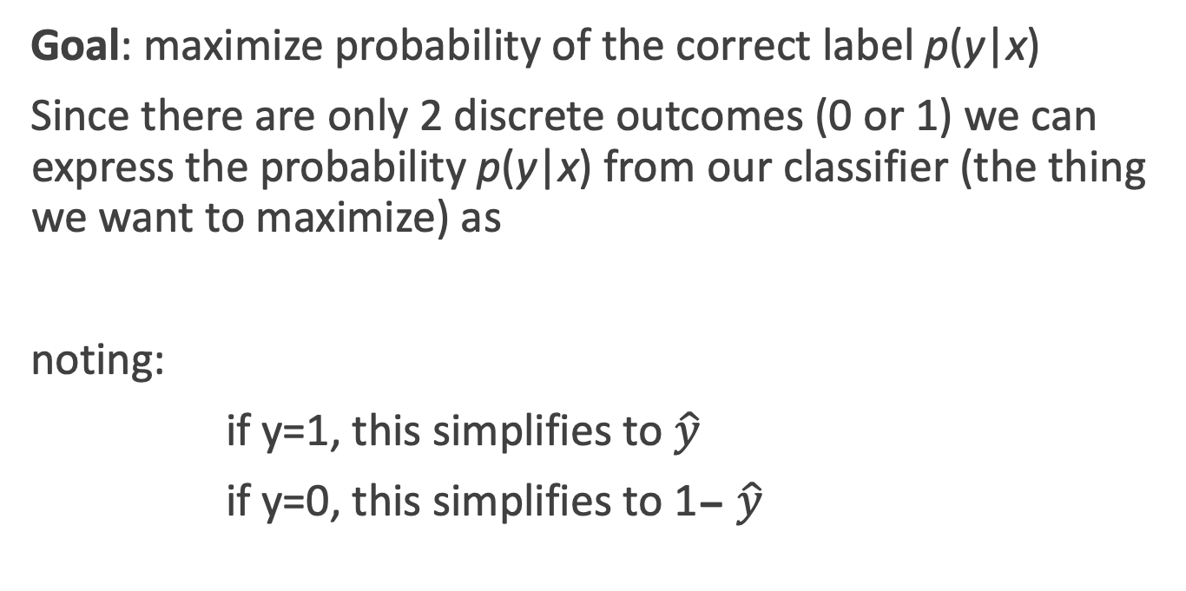
Deriving cross-entropy loss for a single observation x
Goal: maximize probability of the correct label p(y|x)
Since there are only 2 discrete outcomes (0 or 1) we can express the probability p(y|x) from our classifier (the thing we want to maximize) as
noting:
if y=1, this simplifies to $\hat{y}$
if y=0, this simplifies to 1- $\hat{y}$
Notes:
Let’s derive this loss function, applied to a single observation x. We’d like to learn weights that maximize the probability of the correct label, that's p(y|x).

Slide 28
Deriving cross-entropy loss for a single observation x
Goal: maximize probability of the correct label p(y|x)
Maximize:
Now take the log of both sides (mathematically handy)
Whatever values maximize log p(y|x) will also maximize p(y|x)
Maximize:

Slide 29
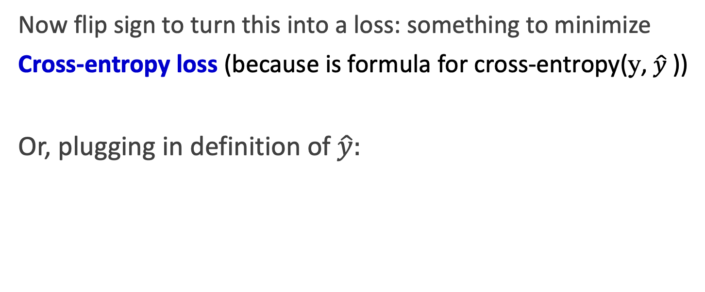
Deriving cross-entropy loss for a single observation x
Goal: maximize probability of the correct label p(y|x)
Maximize:
Now flip sign to turn this into a loss: something to minimize
Cross-entropy loss (because is formula for cross-entropy(y, $\hat{y}$))
Or, plugging in definition of $\hat{y}:$
Minimize:

Slide 30
Let's see if this works for our sentiment example
We want loss to be:
smaller if the model estimate is close to correct
bigger if model is confused
Let's first suppose the true label of this is y=1 (positive)
It's hokey . There are virtually no surprises , and the writing is second-rate . So why was it so enjoyable ? For one thing , the cast is great . Another nice touch is the music . I was overcome with the urge to get off the couch and start dancing . It sucked me in , and it'll do the same to you .

Slide 31
Let's see if this works for our sentiment example
True value is y=1. How well is our model doing?
Pretty well! What's the loss?

Slide 32
Let's see if this works for our sentiment example
Suppose true value instead was y=0.
What's the loss?
Notes:
By contrast, let’s pretend instead that the example was actually negative, i.e., the true y = 0 (perhaps the reviewer went on to say “But bottom line, the movie is terrible! I beg you not to see it!”) . In this case our model is confused, the model is wrong, so we’d want the loss to be higher. Let's plug in y = 0 and 1−σ(w·x+b) = .31

Slide 33
Let's see if this works for our sentiment example
The loss when model was right (if true y=1)
Is lower than the loss when model was wrong (if true y=0):
Sure enough, loss was bigger when model was wrong!

Slide 34
Logistic Regression
Stochastic Gradient Descent
Notes:
In this lecture we introduce the stochastic gradient descent algorithm used for optimizing the weights for logistic regression and neural networks.

Slide 35
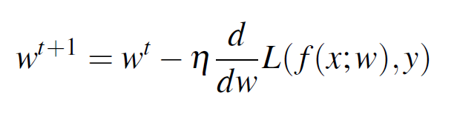
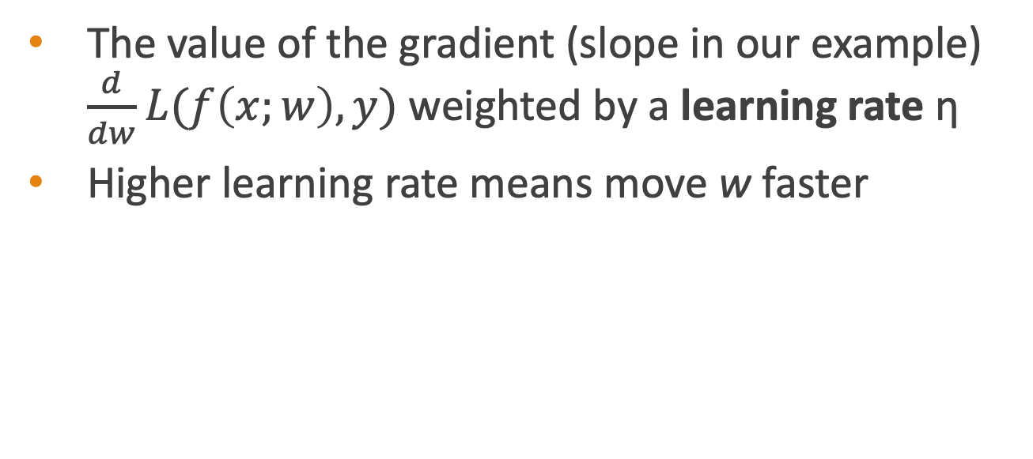
How much do we move in that direction ?
The value of the gradient (slope in our example) $\frac{d}{dw}L(f\left(x;w\right),y)$ weighted by a learning rate η
Higher learning rate means move w faster
Notes:
The magnitude of the amount to move in gradient descent is the value of the slope of the loss function (with respect to w) weighted by a learning rate η . A higher (faster) learning rate means that we should move w more on each step. The change we make in our parameter is the learning rate times the gradient (or the slope, in our single-variable example)

Slide 36
Now let's consider N dimensions
We want to know where in the N-dimensional space (of the N parameters that make up θ ) we should move.
The gradient is just such a vector; it expresses the directional components of the sharpest slope along each of the N dimensions.
Notes:
Now let’s extend the intuition from a function of one scalar variable w to many variables, because we don’t just want to move left or right, we want to know where in the N-dimensional space (of the N parameters that make up θ ) we should move. The gradient is just such a vector; it expresses the directional components of the sharpest slope along each of those N dimensions.

Slide 37
Real gradients
Are much longer; lots and lots of weights
For each dimension w_{i} the gradient component i tells us the slope with respect to that variable.
“How much would a small change in w_{i} influence the total loss function L?”
We express the slope as a partial derivative ∂ of the loss ∂w_{i}
The gradient is then defined as a vector of these partials.
Notes:
In an actual logistic regression, the parameter vector w is much longer than 1 or 2, since the input feature vector x can be quite long, and we need a weight wi for each xi. For each dimension/variable wi in w (plus the bias b), the gradient will have a component that tells us the slope with respect to that variable. Essentially we’re asking: “How much would a small change in that variable wi influence the total loss function L?” In each dimension wi, we express the slope as a partial derivative of the loss function with respect to wi. The gradient is then defined as a vector of these partials.

Slide 38
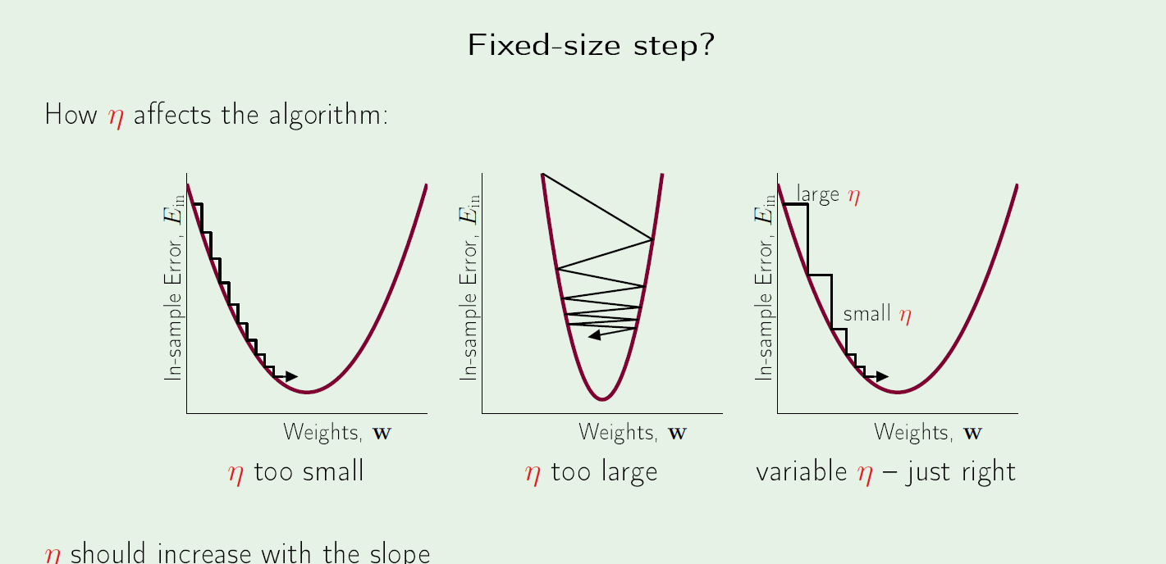
Notes:
If we’re just imagining two weight dimensions (say for one weight w and one bias b), the gradient might be a vector with two orthogonal components, each of which tells us how much the ground slopes in the w dimension and in the b dimension. This figure shows a visualization of the value of a 2-dimensional gradient vector taken at the red point.

Slide 39
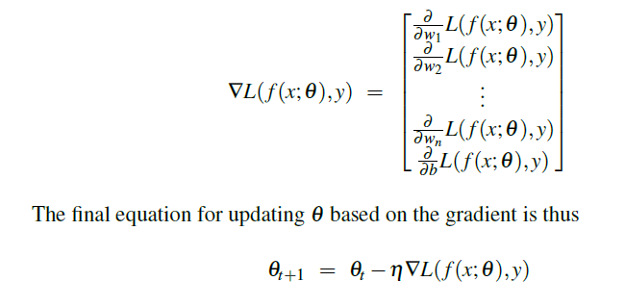

The gradient
We’ll represent $\hat{y}$as f (x; θ ) to make the dependence on θ more obvious:
Notes:
Here's a vector of gradients. We’ll represent yˆ as f (x; θ ) to make the dependence on θ more obvious:

Slide 40
What are these partial derivatives for logistic regression?
The loss function
The elegant derivative of this function (see textbook 5.8 for derivation)
Notes:
In order to update θ , we need a definition for the gradient ∇L( f (x; θ ), y). Recall that for logistic regression, the cross-entropy loss function is: EQ
It turns out that the derivative of this function for one observation vector x is EQ
Note that the gradient with respect to a single weight w j represents a very intuitive value: the difference between the true y and our estimated yˆ = σ (w · x + b) for that observation, multiplied by the corresponding input value x j .

Slide 41
Notes:
Stochastic gradient descent is an online algorithm that minimizes the loss function by computing its gradient after each training example, and nudging θ in the right direction (the opposite direction of the gradient). The algorithm can terminate when it converges (or when the gradient norm < ε), or when progress halts (for example when the loss starts going up on a held-out set).

Slide 42
Hyperparameters
The learning rate η is a hyperparameter
too high: the learner will take big steps and overshoot
too low: the learner will take too long
Hyperparameters:
Briefly, a special kind of parameter for an ML model
Instead of being learned by algorithm from supervision (like regular parameters), they are chosen by algorithm designer.
Notes:
The learning rate η is a hyperparameter that must be adjusted. If it’s too high, the learner will take steps that are too large, overshooting the minimum of the loss function. If it’s too low, the learner will take steps that are too small, and take too long to get to the minimum. It is common to start with a higher learning rate and then slowly decrease it. Hyperparameters are a special kind of parameter for any machine learning model. Unlike regular parameters of a model (weights like w and b), which are learned by the algorithm from the training set, hyperparameters are special parameters chosen by the algorithm designer that affect how the algorithm works.

Slide 43
Logistic Regression
Stochastic Gradient Descent: An example and more details
Notes:
In this lecture we'll walk through an example of stochastic descent and give a few more details.

Slide 44
Working through an example
One step of gradient descent
A mini-sentiment example, where the true y=1 (positive)
Two features:
x₁ = 3 (count of positive lexicon words)
x₂ = 2 (count of negative lexicon words)
Assume 3 parameters (2 weights and 1 bias) in Θ⁰ are zero:
w₁ = w₂ = b = 0
η = 0.1
Notes:
Let’s walk though a single step of the gradient descent algorithm. We’ll use a simplified version of our sentiment classification example as it sees a single observation x, whose correct value is y = 1 (this is a positive review), and with only two features: x1 = 3 (count of positive lexicon words), and x2 = 2 (count of negative lexicon words). Let’s assume the initial weights and bias in θ_0 are all set to 0, and the initial learning rate η is 0.1:

Slide 45
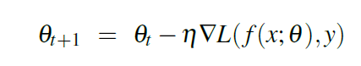
Example of gradient descent
w₁ = w₂ = b = 0;
x₁ = 3; x₂ = 2
Update step for update θ is:
where
Gradient vector has 3 dimensions:
Notes:
Here's our update equation for SGD. In order to do this update to theta, we'll need to know the gradient of the loss function. In our mini example there are three parameters, so the gradient vector has 3 dimensions, for w1, w2, and b. We can compute the first gradient as follows:

Slide 46
Example of gradient descent
w₁ = w₂ = b = 0;
x₁ = 3; x₂ = 2
Update step for update θ is:
where
Gradient vector has 3 dimensions:

Slide 47
Example of gradient descent
w₁ = w₂ = b = 0;
x₁ = 3; x₂ = 2
Update step for update θ is:
where
Gradient vector has 3 dimensions:

Slide 48
Example of gradient descent
w₁ = w₂ = b = 0;
x₁ = 3; x₂ = 2
Update step for update θ is:
where
Gradient vector has 3 dimensions:

Slide 49
Example of gradient descent
w₁ = w₂ = b = 0;
x₁ = 3; x₂ = 2
Update step for update θ is:
where
Gradient vector has 3 dimensions:

Slide 50
Example of gradient descent
Now that we have a gradient, we compute the new parameter vector θ¹ by moving θ⁰ in the opposite direction from the gradient:
η = 0.1;

Slide 51
Example of gradient descent
Now that we have a gradient, we compute the new parameter vector θ¹ by moving θ⁰ in the opposite direction from the gradient:
η = 0.1;

Slide 52
Example of gradient descent
Now that we have a gradient, we compute the new parameter vector θ¹ by moving θ⁰ in the opposite direction from the gradient:
η = 0.1;

Slide 53
Example of gradient descent
Now that we have a gradient, we compute the new parameter vector θ¹ by moving θ⁰ in the opposite direction from the gradient:
η = 0.1;
Note that enough negative examples would eventually make w₂ negative
Notes:
Note that this observation x happened to be a positive example. We would expect that after seeing more negative examples with high counts of negative words, that the weight w2, the weight for the "negative lexicon feature', would shift to have a negative value.

Slide 54
Mini-batch training
Stochastic gradient descent chooses a single random example at a time.
That can result in choppy movements
More common to compute gradient over batches of training instances.
Batch training: entire dataset
Mini-batch training: m examples (512, or 1024)
Notes:
Stochastic gradient descent is called stochastic because it chooses a single random example at a time, moving the weights so as to improve performance on that single example. That can result in very choppy movements, so it’s common to compute the gradient over batches of training instances rather than a single instance.
For example in batch training we compute the gradient over the entire dataset. By seeing so many examples, batch training offers a superb estimate of which direction to move the weights, at the cost of spending a lot of time processing every single example in the training set to compute this perfect direction.
A compromise is mini-batch training: we train on a group of m examples (perhaps 512, or 1024) that is less than the whole dataset.
Mini-batch training also has the advantage of computational efficiency. The mini-batches can easily be vectorized, choosing the size of the mini-batch based on the computational resources. This allows us to process all the exam- ples in one mini-batch in parallel and then accumulate the loss, something that’s not possible with individual or batch training.

Slide 55
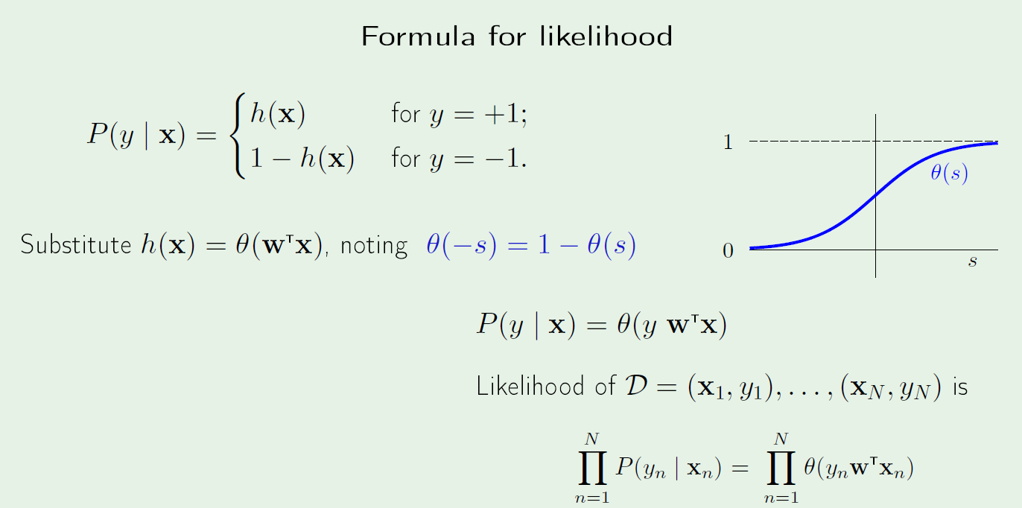
Another form of likelihood with label 1 and -1

Slide 56
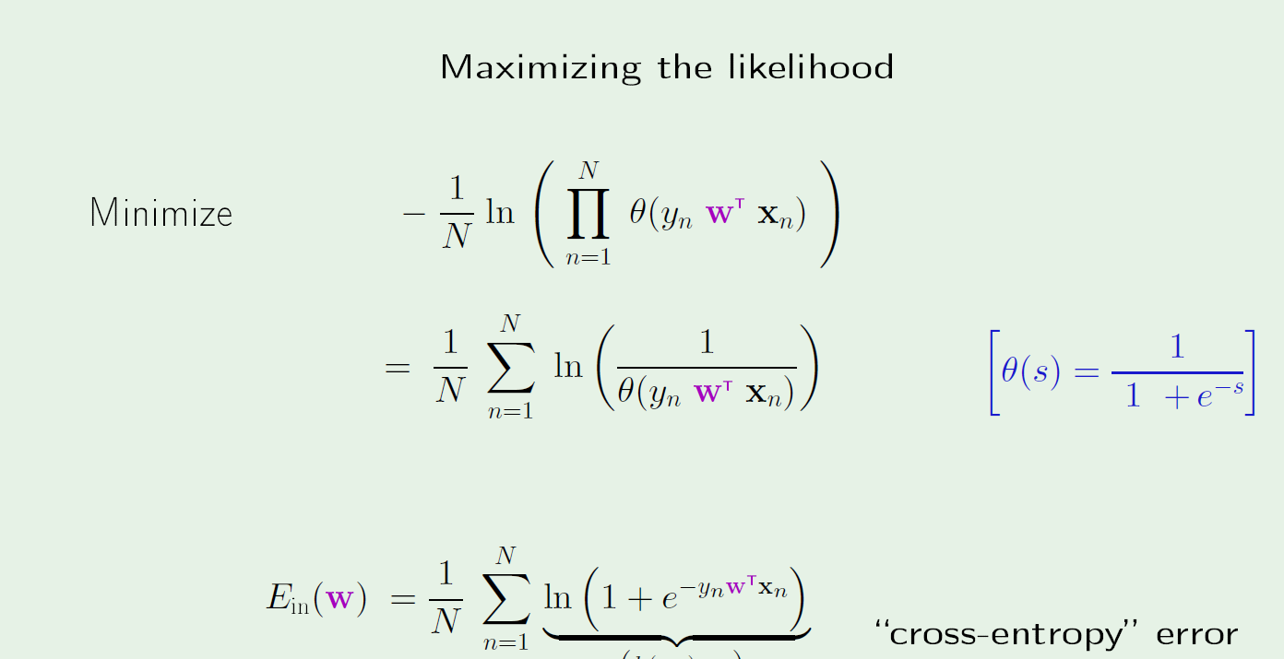

Slide 57
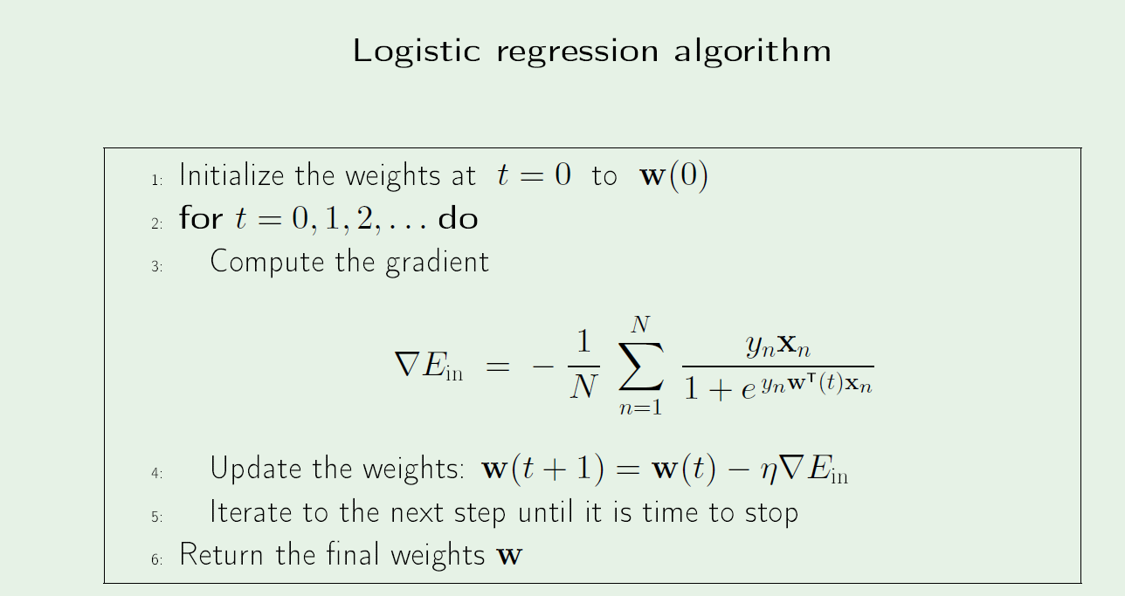

Slide 58
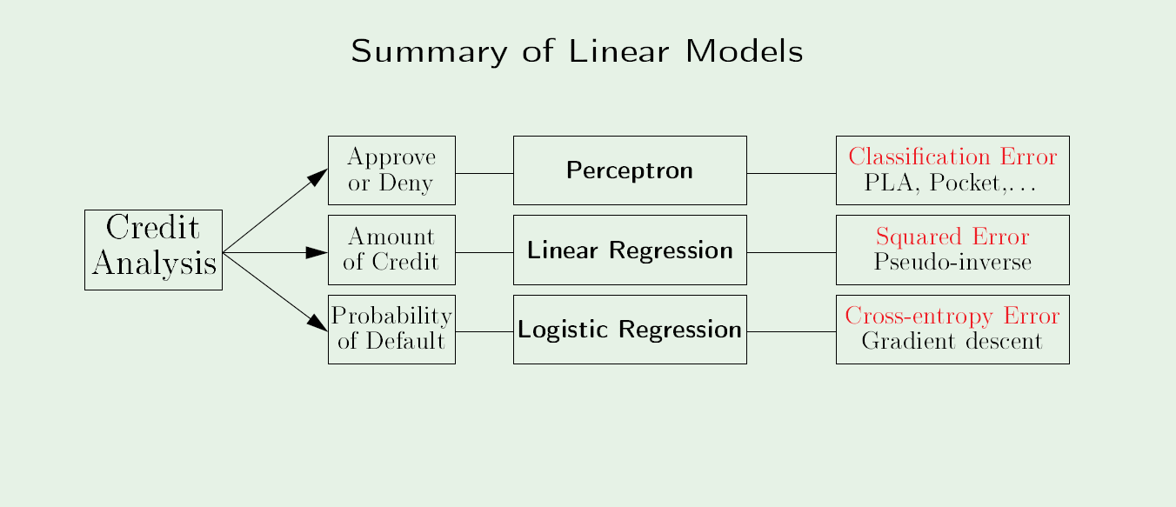

Slide 59
Logistic Regression
Multinomial logistic regression
Notes:
In this lecture we'll walk through an example of stochastic descent and give a few more details.

Slide 60
Multinomial Logistic Regression
Often we need more than 2 classes
Positive/negative/neutral
Parts of speech (noun, verb, adjective, adverb, preposition, etc.)
Classify emergency SMSs into different actionable classes
If >2 classes we use multinomial logistic regression
= Softmax regression
= Multinomial logit
= (defunct names : Maximum entropy modeling or MaxEnt
So "logistic regression" will just mean binary (2 output classes)

Slide 61
Multinomial Logistic Regression
The probability of everything must still sum to 1
P(positive|doc) + P(negative|doc) + P(neutral|doc) = 1
Need a generalization of the sigmoid called the softmax
Takes a vector z = [z1, z2, ..., zk] of k arbitrary values
Outputs a probability distribution
each value in the range [0,1]
all the values summing to 1

Slide 62
The softmax function
Turns a vector z = [z₁, z₂, ... , z_{k}] of k arbitrary values into probabilities

Slide 63
The softmax function
Turns a vector z = [z₁,z₂,...,z_{k}] of k arbitrary values into probabilities

Slide 64
Softmax in multinomial logistic regression
Input is still the dot product between weight vector w and input vector x
But now we’ll need separate weight vectors for each of the K classes.

Slide 65
Features in binary versus multinomial logistic regression
Binary: positive weight → y=1 neg weight → y=0
Multinominal: separate weights for each class:
w₅ = 3.0

Slide 66
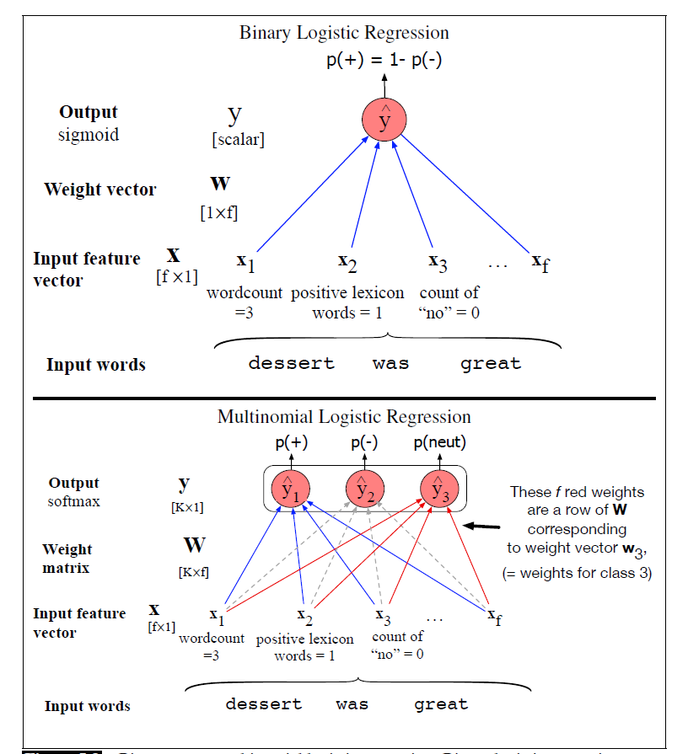

Slide 67
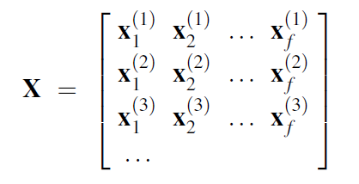
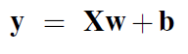
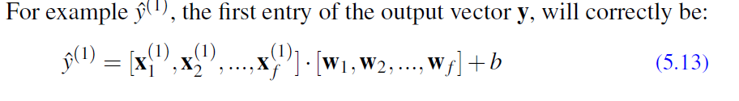
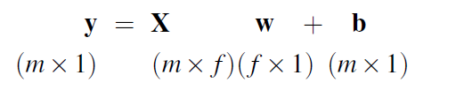
Processing many examples at once

Slide 68
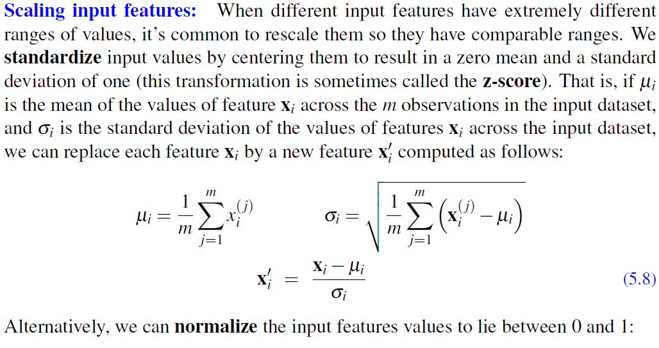
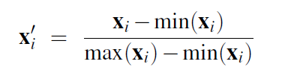

Slide 69
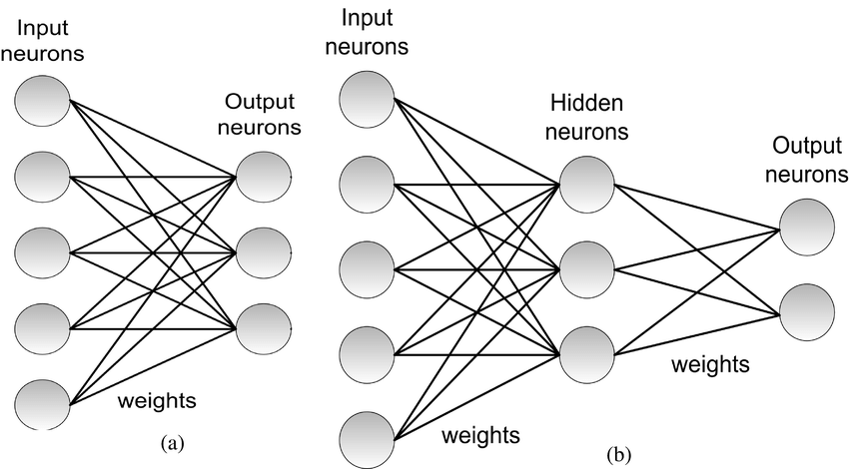
From Multinomial Logistic Regression to Neural Networks
Multinomial Logistic Regression
Neural Netwrok

Slide 70
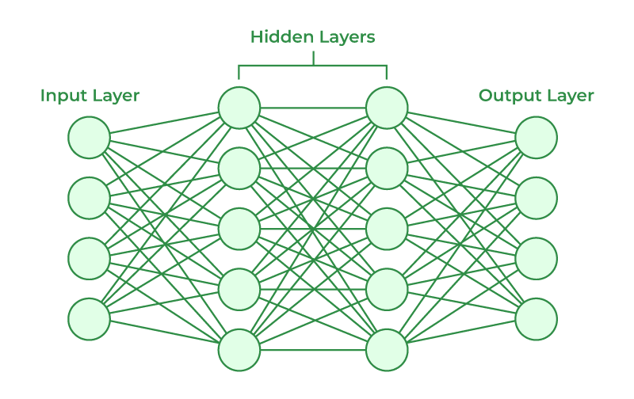
Neural Network

